Slide 1
Welcome to Lewisville High School
DECA

Slide 2
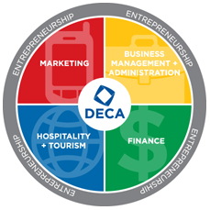
What is DECA?
DECA is an organization that prepares emerging leaders and entrepreneurs for careers in marketing, finance, hospitality and management in high schools and colleges around the world.

Slide 3
Competitive Events
Personal Financial Literacy
Entrepreneurship Team Decision Making
Entrepreneurship Individual Series Events
Retail Merchandising Individual Series Events
Entrepreneurship Innovation Plan
Franchise Business Plan
Fashion Marketing
Sports and Entertainment Management
Principles of Finance
Travel and Tourism Team Decision Making
And nearly 50 more events to choose from!

Slide 4
Competitive Events
Some events allow competitors to work in groups of up to 3 people.
There are two main types of events:
Written: Competitor(s) write a paper and prepare a presentation for a judge.
Roleplay: Competitor(s) receive a prompt and scenario with 10 minutes to review it and then they proceed to present to a judge.

Slide 5
Competitions
District
Location: Irving Convention Center
Testing Date: TBD
Competition Date: January 15, 2019
State
Location: Dallas
Testing Date: TBD
Competition Date: February 21-23, 2019
International
Location: Orlando, Florida
Testing Date: At competition
Competition Date: April 27- 30, 2019

Slide 6
International Career Development Conference
Also known as ICDC! This year DECA students who advance to ICDC get to travel to sunny, Orlando to compete and network. Since competition lasts 2 of the 4 days, you will surely have time to enjoy the city, including attractions like Disney World!

Slide 7
How to Join
To join Lewisville DECA:
Follow the Link to
Sign-Up by using the form by Friday, September 14th
Dues are due at the beginning of4th period Friday 14th
Don’t forget to add us!
Twitter: @Lewisvillebam
Remind: Text @2kbca to 81010

